Slide 1



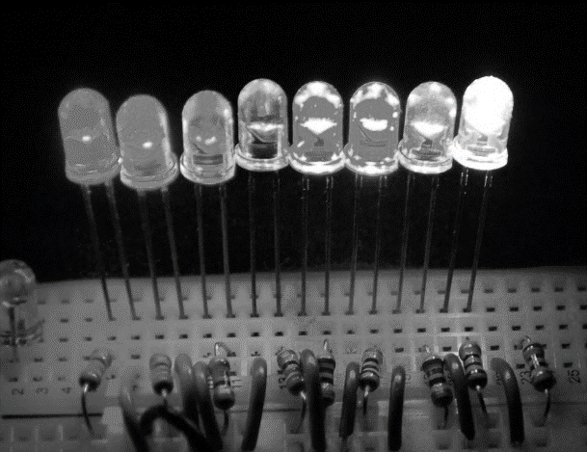
Introduction to Electronics EHB222E

Slide 2

Grading
Grading: Midterm Exams 2x 20%, Quizzes 2x 10%, Final Exam 40%
Midterm Exams: 30 October (could be after 5 pm, time to be arranged) and 10 December 2019
Pop Quizzes: 8 October and 26 November 2019 during regular class hours
Before the final exam the sum of your midterm exam grades should be larger than 50.

Slide 3
Introduction to Electronics
Introduction
Semiconductors & Doping, Basics of pn junction
Diodes
BJT Transistors
MOSFET Transistors
Operational Amplifiers

Slide 4
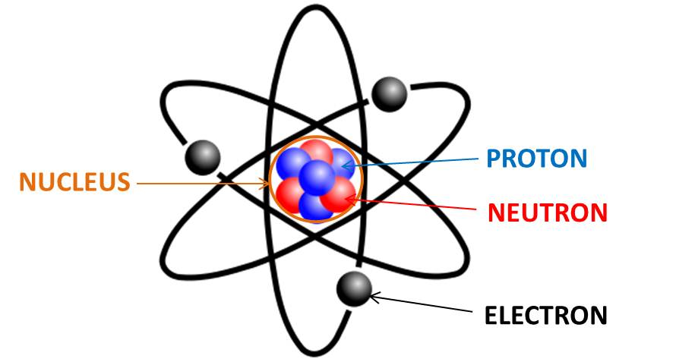
What is Electricity?
Electricity is generated from the motion of tiny charged atomic particles called electrons and protons!
Atoms contain
Protons (+)
Neutrons (0)
Electrons (-)

Slide 5
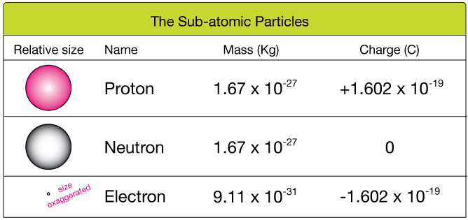
What is Electricity?
Atoms contain
Protons (+)
Neutrons (0)
Electrons (-)
Protons are positively charged and electrons are negatively charged.
The unit of charge is Coulomb (C)

Slide 6
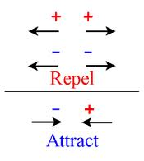
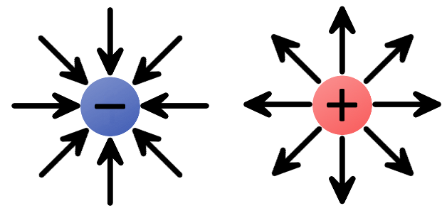
Law of Electric Charges
The law of electric charges states that like charges repel, and opposite charges attract.
Protons are positively charged and electrons are negatively charged, so they are attracted to each other.
A negative charge has an inward electric field because it attracts positive charges.
The positive charge has an outward electric field, pushing away like charges.

Slide 7
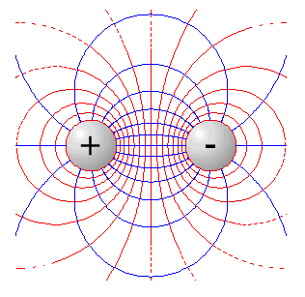
Electric Field
An electric field is the region around a charged object.
The force between the charged objects
is an electric force.
The size of the electric force depends on 2 things:
The amount of charge (the greater the charge, the greater the force)
The distance between charges (the further the distance, the less the force)

Slide 8


Charged Objects
Atoms do not have a charge because the number of electrons and protons cancel each other out.
Example:
3 protons (+) & 3 electrons (-) = 0

Slide 9
Charged Objects
How do objects get charged?
They either gain or lose electrons.
Why not protons?
Example:
3 protons (+) & 5 electrons (-) =
7 protons (+) & 2 electrons (-) =

Slide 10
What is Current?
When electrons flows through a conductor,
we call this flow as “current.”
Only some materials have free electrons inside and allow current flow.
glass
rubber
oil
asphalt
fiberglass
porcelain
ceramic
quartz
(dry) cotton
(dry) paper
(dry) wood
plastic
air
diamond
pure water
YES!
NO!
silver
copper
gold
aluminium
iron
steel
brass
bronze
mercury
graphite
salty water
Conductors:
Insulators:
No free electrons = No current

Slide 11

How Does Current Flow?
Current can only flow through conductors. Good conductors have low resistance so electrons flow through them with ease.
Metal wires (conductors)
+++
Current flow

Slide 12
When Does Current NOT Flow?
Current cannot flow through insulators.
Plastic material (insulators)
+++
No current flow

Slide 13
Note that Air is an Insulator
Current cannot flow through insulators
+++
Air
No current flow
That’s why a battery doesn’t discharge if left on its own.

Slide 14
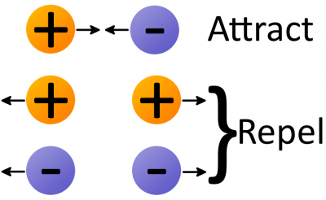
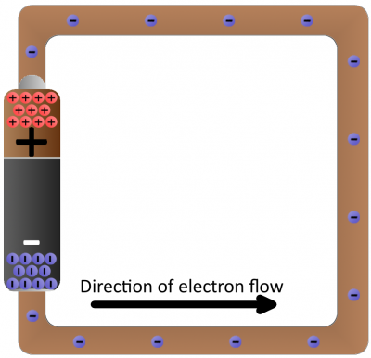
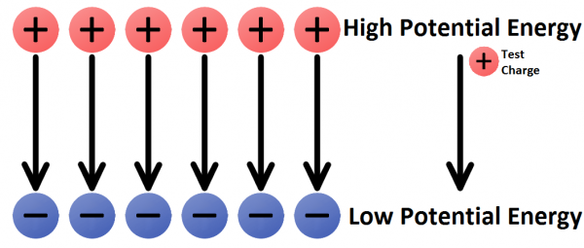
What is Voltage?
- measured in volts.
Voltage is the difference in energy level from one end of the battery (or any other energy source) to the other.
The energy difference causes the negative charges to move from a lover voltage level to higher voltage in a closed circuit

Slide 15
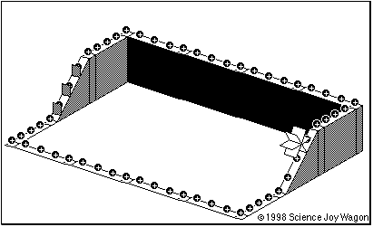
A battery in an electrical circuit plays the same role as a pump in a water system.
A battery establishes a difference of potential that can pump electrons.
A battery pushes the electrons through the conductor.

Slide 16
Current
Current is the amount of electric charge (coulombs) flowing through a cross section of a conductor in one second.
1 Ampere = 1 Coulomb/second
Electron flow is from a lower potential (voltage) to a higher potential (voltage).
Current flow is from a higher potential (voltage) to a lower potential (voltage).
Direction of current flow
higher potential
lower potential

Slide 17
Sign Convention for Current Flow
Electrons carry negative charge
Current flow is in opposite direction
-
-
-
-
-
-
-
-
-
-
-
-
-
-
-
-
-
-
-
-
-
-
-
-
electron motion
Current direction

Slide 18
Current Flow
The direction of current flow is indicated by an arrow.
DC Voltage Source
+
_
higher potential
Note: The voltage sources in the circuit flow current through nodes and wires.
Current flow is from a higher potential (voltage) to a lower potential (voltage).

Slide 19
Electric Circuit
If two or more nodes are connected just by wires, intersection point can be considered as one single node.
Intersection point of wires is call as a node
Nodes are Connected
by Wires Only
A single node
One big node
Electronic elements
Conducting wires
+
_
Group of nodes connected only by wires
One big node

Slide 20
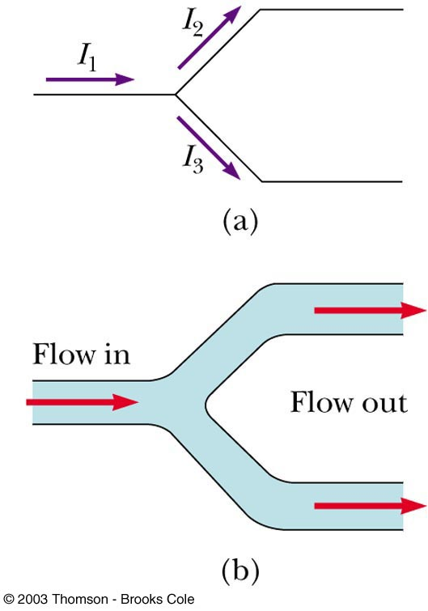
From Conservation of Charge
Current is the amount of electric charge (coulombs) flowing through a cross section of a conductor in one second
The sum of charges flowing into a node must be equal to the sum of the charges flowing out of the node.
I₁ = I₂ + I₃
Diagram b shows a mechanical analogy

Slide 21
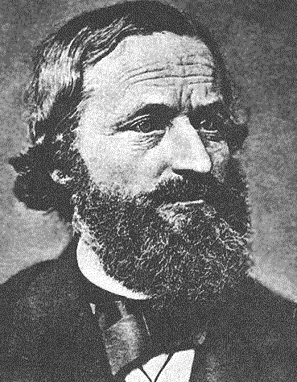
Kirchhoff’s Current Law
The sum of currents flowing into a node must be balanced by the sum of currents flowing out of the node.
i₁
node
i₂
i₃
Gustav Kirchoff was an 18th century German mathematician
+
_
i₁ flows into the node
i₂ flows out of the node
i₃ flows out of the node
i₁ = i₂ + i₃

Slide 22
Kirchhoff’s Current Law:
i₁ = i₂ + i₃ can also be written in the following form:
i₁ – i₂ – i₃ = 0
The sum of all the currents entering a node is zero.
DC Voltage Source
i₁
node
i₂
i₃
+
_
(i₂ and i₃ leave the node, hence currents –i₂ and –i₃ enter the node.)

Slide 23
Example 1: Kirchhoff’s Current Law:
Q: How much is the current I_{o} ?
A: i_{o} = 2.5 mA + 4 mA = 6.5 mA
DC Current Source
2.5 mA
4 mA
i_{o}
i₄
i₂
i₃
The dotted circle is a node with 2.5 mA entering
Hence i₂ = 2.5 mA exits the “node”.
Similarly, i₃ = 4 mA.
From KCL, i₄ = i₂ + i₃ = 6.5 mA, and I_{o} = i₄

Slide 24
Example 2: Kirchhoff’s Current Law:
Q: How much are the currents i₁ and i₂ ?
A: i₂ = 10 mA – 3 mA = 7 mA
i₁ = 10 mA + 4 mA = 14 mA
10 mA
node
i₁
3 mA
i₂
4 mA
+
_

Slide 25
Sometimes Kirchhoff’s Current Law is abbreviated just by
KCL
Review: Different ways to state KCL:
The sum of all currents entering a node must be zero.
The net current entering a node must be zero.
Whatever flows into a node must come out.
more to follow…

Slide 26
Voltage (Difference in energy level )
Voltages are measured across the nodes of a circuit.
The direction of a voltage is indicated by + and – signs.
+ v₂ –
+
v₁
–
+
v₃
–
+
v₄
–
+
_
higher potential
lower potential

Slide 27
Kirchhoff’s Voltage Law
The voltage measured between any two nodes does not depend of the path taken.
voltage
+ v₂ –
voltage
+
v₁
–
+
v₃
–
+
v₄
–
+
voltage
_
Example of KVL:
v₁= v₂ + v₃
Similarly:
v₁= v₂ + v₄
and:
v₃= v₄

Slide 28
Kirchhoff’s Voltage Law: v₁ = v₂ + v₃
This equation can also be written in the following form:
–v₁ + v₂ + v₃ = 0
+ v₂ –
+
v₁
–
+
v₃
–
+
v₄
–
+
_
A formal statement of Kirchhoff’s Voltage Law:
The sum of voltages around a closed loop is zero.

Slide 29
Using the Formal Definition of KVL
“The sum of voltages around a closed loop is zero.”
Define an arrow direction around a closed loop.
Sum the voltages that are encountered around the loop.
If the arrow first encounters a plus sign, enter that voltage with a (+) into the KVL equation.
If the arrow first encounters a minus sign, enter that voltage with a (–) into the KVL equation.
+ v₂ –
+
v₁
–
+
v₃
–
+
v₄
–
+
_
For the inner loop :
–v₁ + v₂ + v₃ = 0
For the outer loop:
–v₄ – v₂ + v₁ = 0

Slide 30
Example 1: Kirchhoff’s Voltage Law:
Q: How much is the voltage V_{o} ?
A: V_{o} = 3.1 V + 6.8 V
+ 3.1V –
+
6.8V
–
+
v₄
_
+
_
V_{o}
Q: How much is the voltage v₄ ?
A: v₄ = 6.8 V

Slide 31
Example 2: Kirchhoff’s Voltage Law:
Q: If v₁ = 10 V and v₅ = 2 V, what are v₂, v₃, and v₄?
-v₁ + v₂ = 0 ⇒ v₂ = 10 V
-v₂ + v₃ + v₅ = 0 ⇒ v₃ = 10 V – 2 V = 8 V
-v₄ + v₅ = 0 ⇒ v₄ = 2 V
+ v₃ –
+
v₂
–
+
v₄
–
+
v₅= 2 V
–
+
v₁ = 10 V
–
+
_

Slide 32
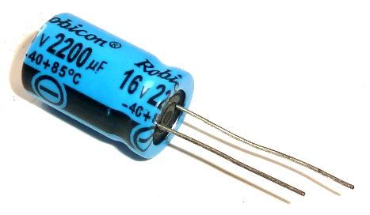
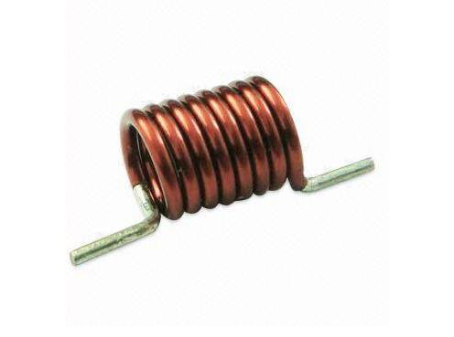
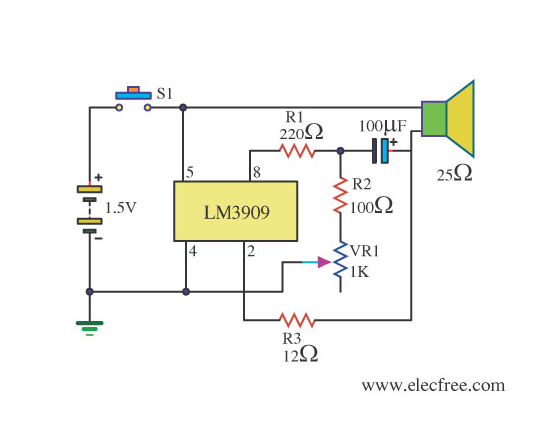

Electronic Circuits
Circuits are obtained by connecting electronic elements
Typical electronic elements are
diodes
resistors,
capacitors,
inductors

Slide 33
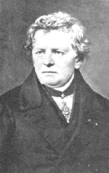
Ohm’s Law & Resistors
Let us remind the Ohm’s Law
V
I = ——
R
V
+
_
V
R = ——
I
Georg Ohm
Assume that the wires are “perfect conductors”
The unknown circuit element limits the flow of current.
The resistive element has resistance R

Slide 34
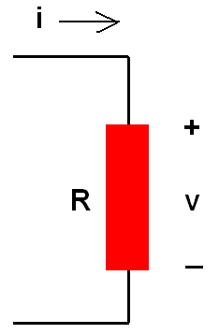
Ohm’s Law
Voltage drop across a resistor is proportional to the current flowing through the resistor
If the resistor is a perfect conductor (or a short circuit)
R = 0Ω, then
v = iR = 0 V
no matter how much current is flowing through the resistor

Slide 35
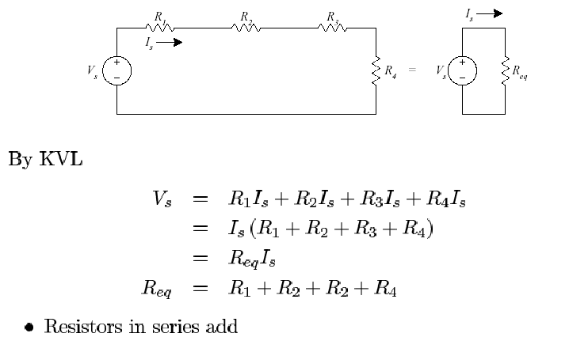
Resistors in Series

Slide 36
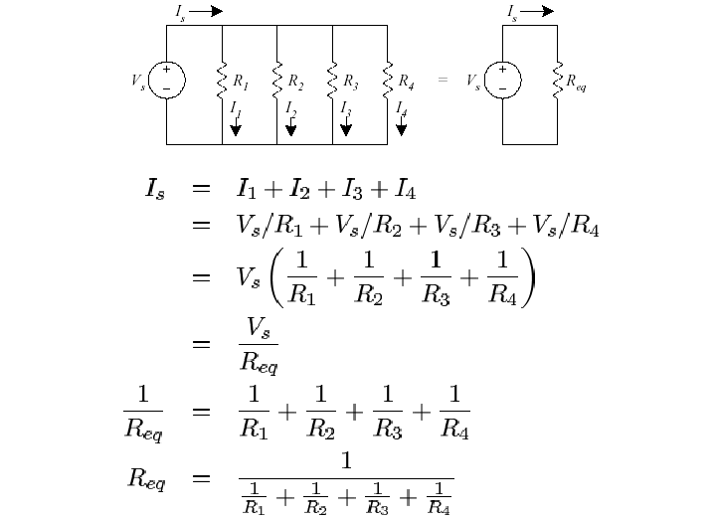
Resistors in Parallel

Slide 37
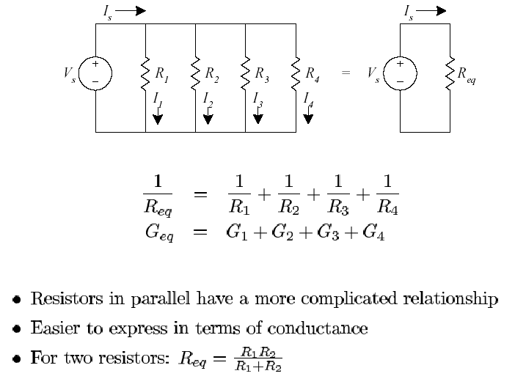
Resistors in Parallel

Slide 38
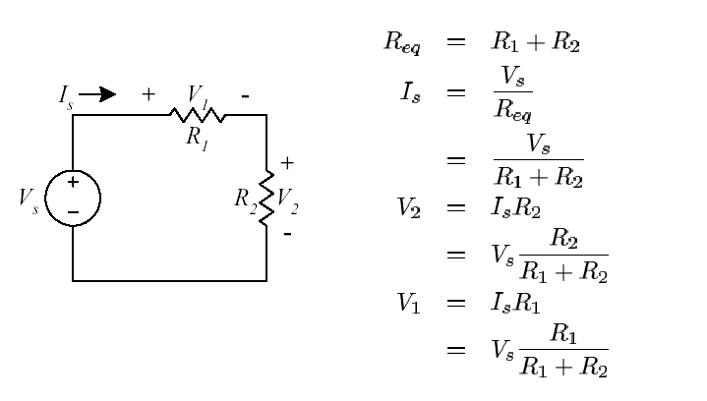
Voltage Divider

Slide 39
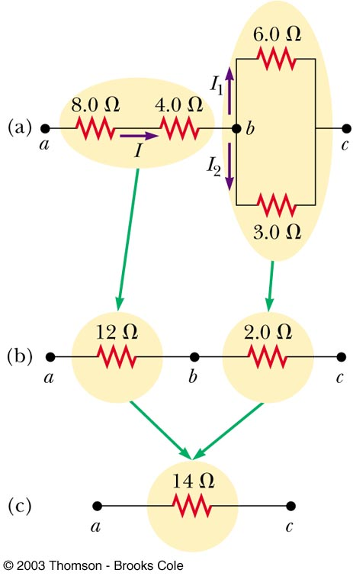
Equivalent Resistance – Complex Circuit

Slide 40
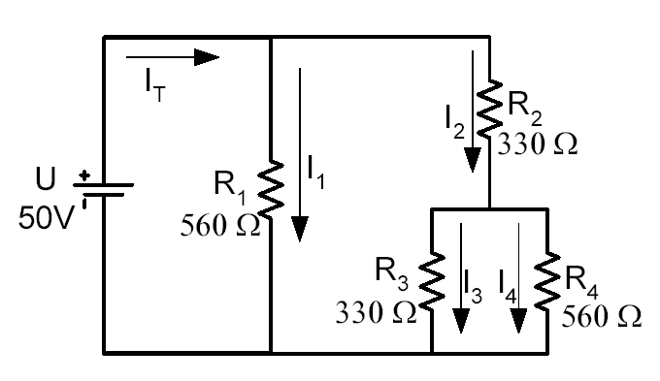
Example: Calculate the current which is flowing through R4.

Slide 41
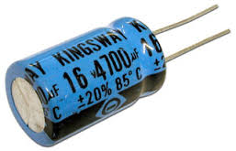
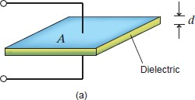
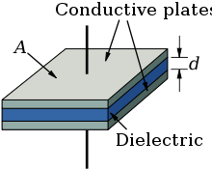
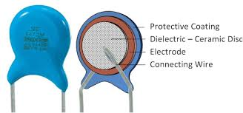
CAPACITOR Energy Storage Device

Slide 42
Maximum Charge on a Conductor
A battery establishes a difference of potential that can pump electrons e⁻ from a ground (earth) to a conductor
Battery
Conductor
-
-
-
-
-
Earth
-
-
e⁻
e⁻
-
-
-
-
-
-
-
There is a limit to the amount of charge that a conductor can hold without leaking to the air. There is a certain capacity for holding charge.

Slide 43
Capacitance
The capacitance C of a conductor is defined as the ratio of the charge Q on the conductor to the potential V produced.
Battery
Conductor
-
-
-
-
-
Earth
-
-
e⁻
e⁻
-
Q, V
-
-
-
-
-
-
Capacitance:

Slide 44
The Capacitor
Capacitors are one of the fundamental passive components. In its most basic form, it is composed of two conducting plates separated by a dielectric material.
The ability to store charge is the definition of capacitance.
Conductors
Dielectric

Slide 45
Initially uncharged
capacitor

Slide 46
Charging

Slide 47
Fully charged
After fully charged, a capacitor behaves as an open circuit and does not allow current flow.

Slide 48
Source removed
A capacitor with stored charge can act as a temporary battery.

Slide 49
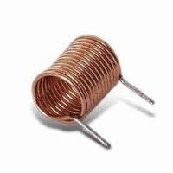
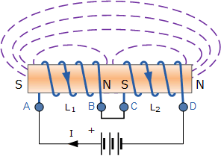
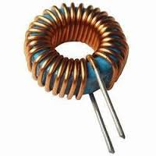
INDUCTORs

Slide 50
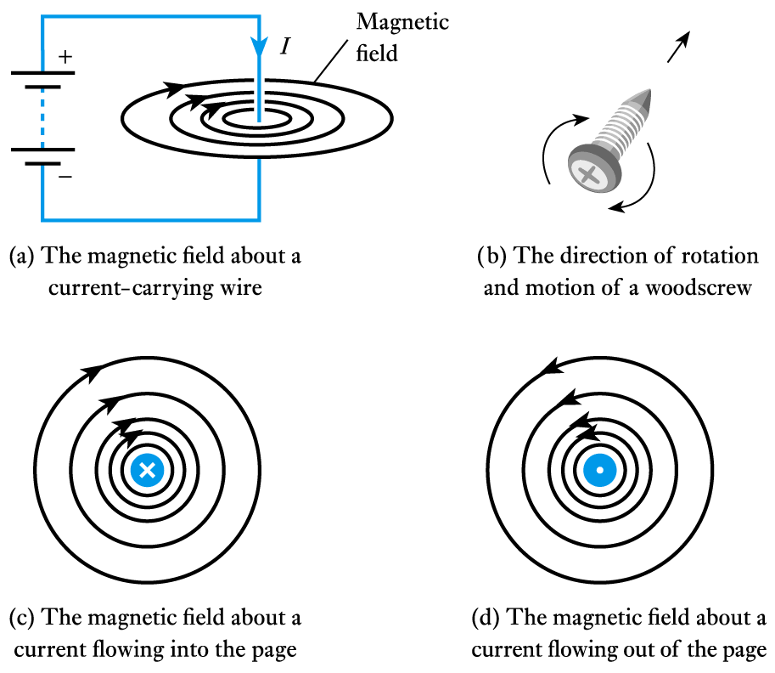
Electromagnetism
A wire carrying a current produces a magnetic field

Slide 51
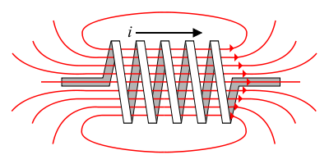
Inductance
Energy Storage Device
Stores energy in an magnetic field created by the electric current flowing through it.
The flow of current through an inductor creates a magnetic field
If the current flowing through the inductor drops, the magnetic field will also decrease and energy is released through the generation of a current.
B field

Slide 52
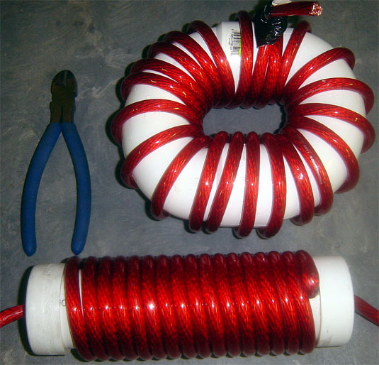
Inductors
Conducting wire is wrapped around a solid core. If no core is used, then the inductor is said to have an ‘air core’.

Slide 53
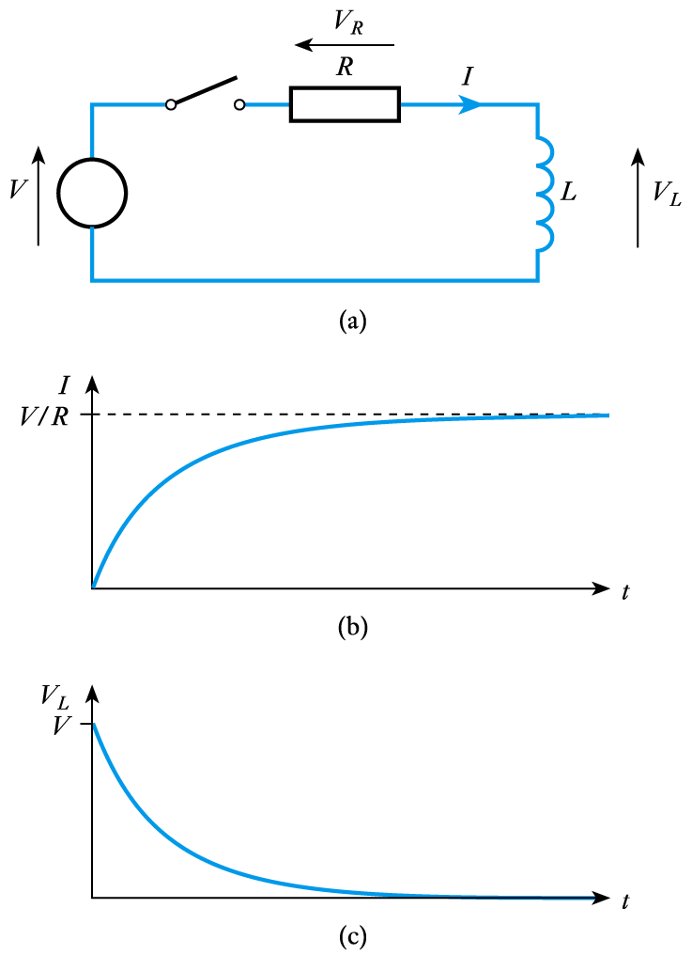
Voltage and Current Relation
Consider the circuit shown here
inductor is initially un-energised
current through it will be zero
switch is closed at t = 0
I is initially zero
hence V_{R} is initially 0
hence V_{L} is initially V
as the inductor is energised:
I increases
V_{R} increases
hence V_{L} decreases
we have exponential behaviour

Slide 54
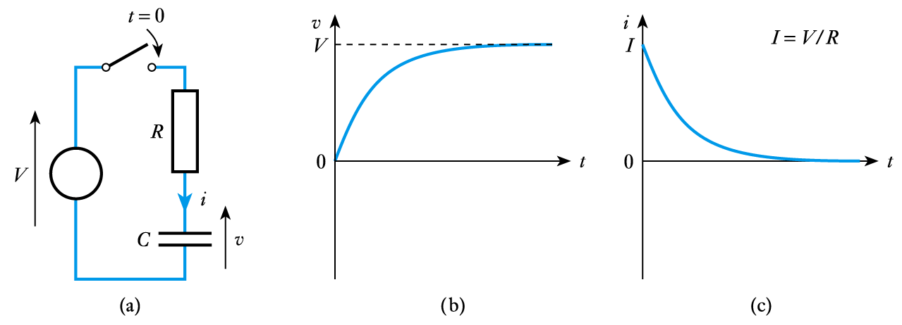
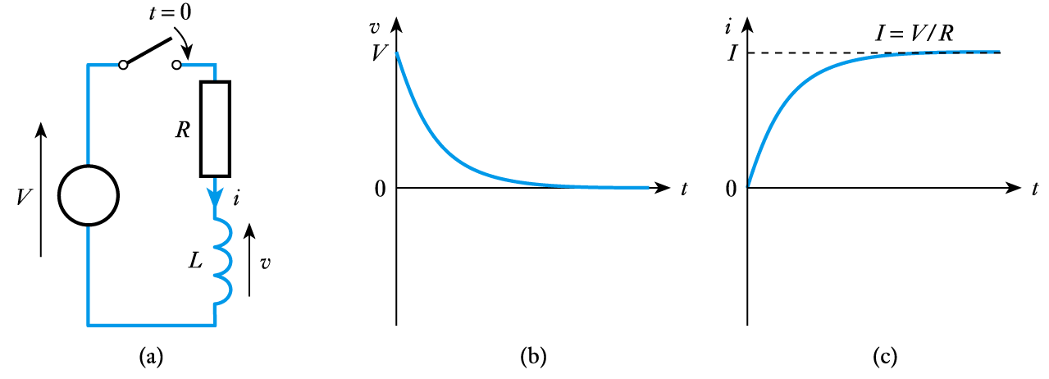
Both the voltage and current have an exponential forms
C, capacitance, has the unit of Farad (F)
1 F = 1 A.sn/V
L, inductance, has the unit of Henry (H)
1 H = 1 V.sn/A

Slide 55
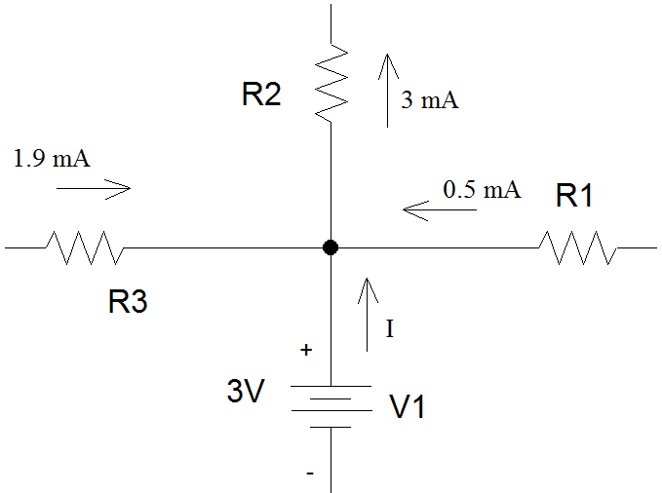
Example 1
Determine I, the current flowing out of the voltage source.
Use KCL
1.9 mA + 0.5 mA + I are entering the node.
3 mA is leaving the node.
V1 is generating 3V.

Slide 56
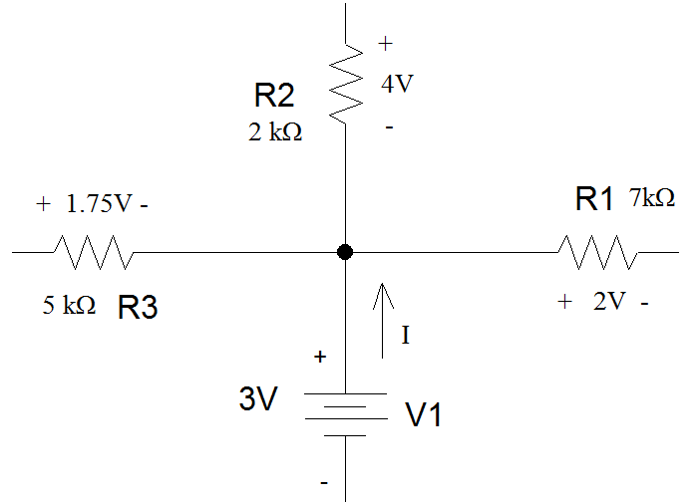
Example 2
If voltage drops are given instead of currents, you need to apply Ohm’s Law to determine the current flowing through each of the resistors before you can find the current flowing out of the voltage supply.

Slide 57
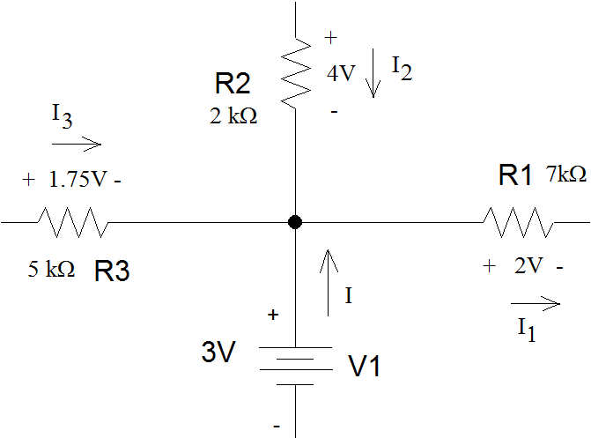
Example 2 (con’t)
For power dissipating components such as resistors, current flows into the resistor at the terminal has the + sign on the voltage drop and leaves out the terminal that has the – sign.
I1 is leaving the node.
I2 is entering the node.
I3 is entering the node.
I is entering the node.

Slide 58
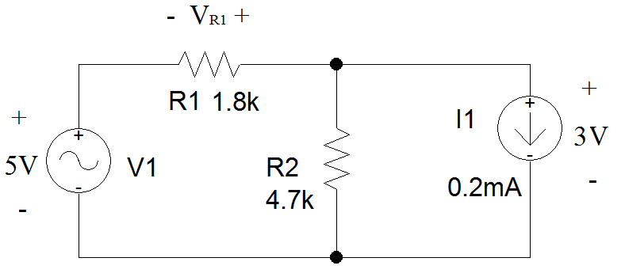
Example 3
Find the voltage across R1. Note that the polarity of the voltage has been assigned in the circuit schematic.
First, define a loop that include R1.

Slide 59
Example 3 (con’t)
There are three possible loops in this circuit. Only two of them include R₁. Either loop may be used to determine V_{R1}.

Slide 60
Example 3 (con’t)
If the outer loop is used, follow the loop clockwise.

Slide 61
Example 3 (con’t)
Follow the loop in a clockwise direction.
The 5V drop across V1 is a voltage rise.
V_{R1} should be treated as a voltage rise.
The loop enters on the positive side of the CURRENT source and exits out the negative side. This is a voltage drop as the voltage becomes less positive as you move through the component.

Slide 62
Example 3 (con’t)
Suppose you chose the green loop instead.
Since R₂ is in parallel with I₁, the voltage drop across R₂ is also 3V.

Slide 63
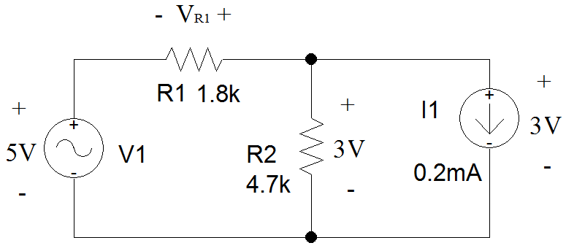
Example 3 (con’t)
Follow the loop in a clockwise direction.
The 5V drop across V1 is a voltage rise.
V_{R1} should be treated as a voltage rise.
The loop enters R₂ on the positive side and exits out the negative side. This is a voltage drop as the voltage becomes less positive as you move through the component.

Slide 64
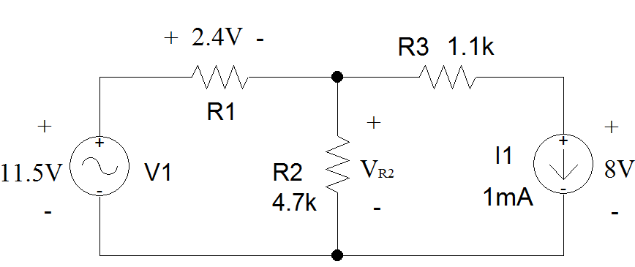
Example 4
Find the voltage across R₂ and the current flowing through it. First, draw a loop that includes R₂.

Slide 65
Example 4 (con’t)
There are two loops that include R₂.
The one on the left can be used to solve for V_{R2} immediately.

Slide 66
Example 4 (con’t)
Follow the loop in a clockwise direction.
The 11.5V drop associated with V₁ is a voltage rise.
The 2.4V associated with R₁ is a voltage drop.
V_{R2} is treated as a voltage drop.

Slide 67
Example 4 (con’t)

Slide 68
Example 4 (con’t)
If you use the right-hand loop, the voltage drop across R₃ must be calculated using Ohm’s Law.

Slide 69
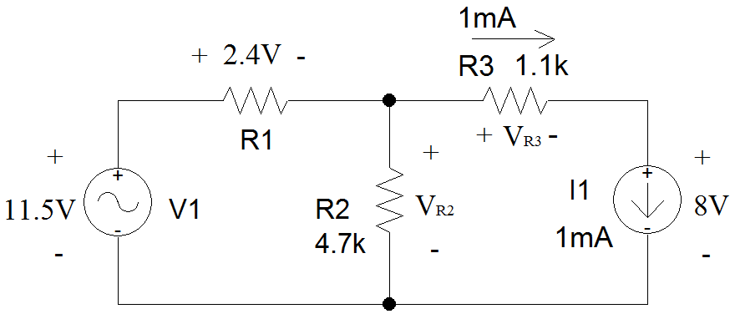
Example 4 (con’t)
Since R3 is a resistor, passive convention means that the positive sign of the voltage drop will be assigned to the end of R3 where current enters the resistor.
As I1 is in series with R3, the direction of current through R3 is determined by the direction of current flowing out of the current source.
Because I1 and R3 are in series, the magnitude of the current flowing out of I1 must be equal to the magnitude of the current flowing out of R3.
Use Ohm’s Law to find V_{R3}.

Slide 70
Example 4 (con’t)
Moving clockwise around the loop:
V_{R3} is a voltage drop.
The voltage associated with I1 is a voltage drop.
V_{R2} is a voltage rise.
Again, the same answer is found.

Slide 71
Example 4 (con’t)
Once the voltage across R₂ is known, Ohm’s Law is applied to determine the current.
The direction of positive current flow, based upon passive sign convention is shown in red.
I_{R2}

Slide 72
Example 4 (con’t)
I_{R2}

